Slide 1
30RFP Education Research Funding Programme (ERFP) Grant Call Briefing
A/P Rita Elaine Silver, Director, ERFPO
Dr Elizabeth Koh, Deputy Director, ERFPO
12 September 2023

Slide 2
ERFP Grant Call Information

Slide 3
Programme
S/N | Item | Presenter/Facilitator | Timing
1 | Welcome | A/P Rita Elaine Silver Director ERFPO | 3.00pm
2 | Presentation on 30RFP ERFP Grant Call Information |  | 3.05pm – 3.30pm
2 | Presentation on 30RFP ERFP Grant Call Information | Dr Elizabeth Koh Dep Dir ERFPO
3 | Presentation on MOE Research Priorities |  | 3.30pm – 3.50pm
3 | Presentation on MOE Research Priorities | A/P Rita Elaine Silver Director ERFPO
4 | Administrative Matters and Supporting Information addressed by Director ERFPO |  | 3.50pm – 4.15pm
5 | Participants proceed to breakout rooms |  | 4.15pm – 4.25pm
6 | Breakout Session Breakout room 1: Instructional Core – Dr Divya Bhardwaj Breakout room 2: Preparation on Programmatic Proposals – A/P Gregory Arief D Liem Note: Participants will leave the meeting channel after the breakout session. There is no need to return to the main room | Respective facilitators | 4.25pm – 5.00pm

Slide 4
About ERFP
The Education Research Funding Programme (ERFP) is a research fund supported by the Ministry of Education (MOE), Singapore and administered by ERFP Office (ERFPO) for all eligible education researchers in Institutes of Higher Learning (IHL).
The 5th tranche of ERFP (FY2023-FY2027) will continue to build on the work that has been undertaken in the previous cycles of education funding by strengthening the foundation (in terms of knowledge, capability, and structure) for education research, development and innovation in existing and emerging research areas.
ERFPO will encourage efforts to design, develop and implement strategic, evidence-based, collaborative, scientifically-rigorous and outcomes-focused innovations in schools and classrooms. The primary aims are to improve classroom practice, enhance student outcomes, and build organizational and teacher capacities.

Slide 5
Scope
Projects should fall within the following scope:
Early childhood, primary, secondary and/or junior college/centralised institute education-related.
Studies on other parts of the education system that link to the emphasis of ERFP might be considered if those links are clearly articulated.
May involve formal or informal learning linked to (a).
Teacher education and teacher professional learning for Singapore’s education system.
Studies of pathways of education and/or lifelong learning which are based in or include participants from higher education are allowed (bearing in mind (b)). Projects that are limited to benefits for higher education not related to (a) are excluded.
Meta-analysis/meta-synthesis studies can be submitted for funding if the studies meet all of the ERFP requirements. This includes ensuring that the scope of the synthesis is well-defined, and the proposed budget and methodology are clearly articulated in line with the intended scope. Traditional literature reviews are not within the funding scope.
International comparisons are allowed but international data collection, analysis or hiring is not supported.

Slide 6
Funding Quantum
TIER | QUANTUM
1 | < S$200K
2 | S$200K to < S$450K
3 / Programmatic Proposal | ≥ S$450K
Quantum
The quantum accommodates the 30% indirect cost.

Slide 7
Grant Categories
‘Research’ grants have the overarching purpose of producing new knowledge or addressing a theoretical issue/problem which may lead to improvements in classroom practice, enhancing student outcomes, and building organizational and teacher capacities. They should be situated within a broader international understanding but have clear, local relevance.
‘Development’ grants must have a clear focus on developing, implementing and evaluating deliverables which are generally usable ‘products’ (e.g. new curriculum, educational tools, databases, etc.) in the local context. These might be translation projects that build on and evaluate an implementation from a previous grant. Development grants should recognize relevant international work but the focus is on local deliverables/outputs.
‘Programmatic’ research is defined by an over-arching research theme which focuses on a key educational issue, problem, phenomena or outcome, along with a number of interlinked sub-themes. The sub-themes are investigated through specific research studies (i.e. ‘projects’) that address important aspects or components of the over-arching issue, problem, phenomena or outcome. Programmatic research therefore has a common strand or focus, supported by a common theoretical framework, and undertakes a coherent, comprehensive, multi-faceted approach to understanding and addressing the issue, problem, phenomena or outcome.

Slide 8
Programmatic Research – Submission Process
Submission Process and Details
All Programmatic Proposals applications are submitted online via ROMS.
Programmatic research may have team members from different IHLs e.g., Co-PI or Collaborator from different institutions.

Slide 9
Programmatic Research - Scope
Scope
Programmatic research is defined by an over-arching research theme which focuses on a key educational issue, problem, phenomena or outcome, along with a number of interlinked sub-themes. The sub-themes are investigated through specific research studies (i.e., ‘projects’) that address important aspects or components of the over-arching issue, problem, phenomena or outcome. Programmatic research therefore has a common strand or focus, supported by a common theoretical framework, and undertakes a coherent, comprehensive, multi-faceted approach to understanding and addressing the issue, problem, phenomena or outcome.
Programmatic research is a specific category of proposal which has Tier 3 funding quantum but a specific project structure. Programmatic research is not applicable to Tier 1 and Tier 2 proposals.

Slide 10
Programmatic Research - Project Structure
Lead PI & Co-Lead PI (Mandatory)
Project
Project 1 PI
Project 2 PI
Project 3 PI
Project n* PI
*The average number of themes for a typical programmatic research is between two to five.
Diagram showing the relationship of Programmatic Project and its Projects

Slide 11
Programmatic Research - Budget Structure
Common Budget
(E.g. equipment, hiring of RAs for common cross-theme tasks, project manager, liaison officer, admin staff, impact videos)
Managed by
Lead PI & Co-Lead PI
Project 1
Budget
Project 2
Budget
Project 3
Budget
Project n
Budget
Managed by
Sub-Project PIs & Co-PIs with regular reporting to the Lead PI & Co-Lead PI
…
A graphical overview of the programme’s budget structure
Note: For further information on Programmatic Research, please refer to the 30RFP ERFP Administrative Guidelines

Slide 12
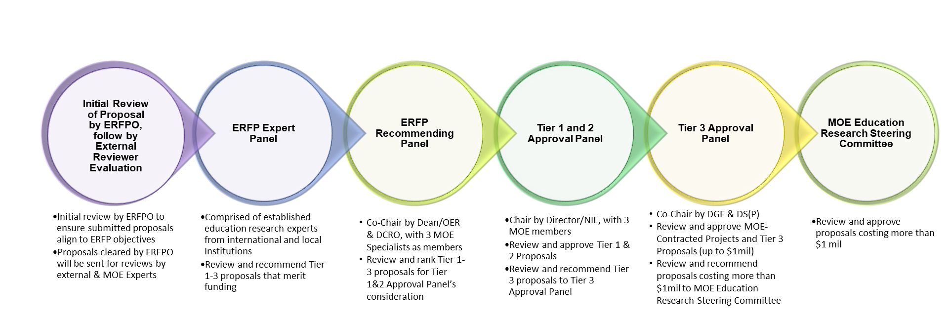
Grant Application Review Process
The Approval Panel Meetings convene twice a year in tandem with the grant call cycle.

Slide 13
Principal Investigator (PI) and Team Member Eligibility Criteria
PI Eligibility Requirement
Full time staff (hired on the IHL’s academic track / academic contract or research track) and funded by the institution (i.e. not funded by project funds). A full-time appointment is defined as a minimum of 9 months a year.
For research grants, applicants must have a doctorate degree.
For development grants, applicants should preferably have a doctorate degree although it is not compulsory.
Applicants applying for Tier 2 and 3 grants must have demonstrated track record in securing national grants and leading independent research as PI or co-PI.
Team Member Eligibility Requirement
Full time staff (hired on the IHL’s academic track / academic contract and research track) can apply as team members (Co-PI and Collaborators)
Non-academic staff with expertise that is relevant to the project can be a research team member with justifications on the role, e.g. MOE Experts
All projects need to include at least one Co-PI from the same institution who meets the PI eligibility requirement at that tier to ensure continuity of the project should the original PI be unable to continue.

Slide 14
Principal Investigator’s Responsibilities and Obligations
Principal Investigator (PI) Role (see ERFP Administrative Guidelines 4.6)
Management of the project, research team and budget in ways which accomplish the project objectives in a satisfactory and timely manner
Seek approval from the relevant institution for ethics clearance and from MOE for collecting data in MOE schools (MOE DAC)
Timely reports, including any requests for amendment: Changes in time frame, research team, budget, participants/sample, research questions, etc. require a request for amendment
Various reports are required, e.g.
Half yearly progress reports
Final report and respective supporting documents
Final Statement of Account
Final Report Form
Final Closure Report
Research Brief
Research data management documentation
Presentation to MOE (occasionally other presentations are requested)

Slide 15
Debarment
ERFP Administrative Guidelines Enclosure 1 Section 6.15 Debarring of Principle Investigators.
PI who fails to submit the Final Report and/or Final Statement of Account within the stipulated deadline will be debarred. Debarred PIs will not be eligible to submit grant applications as PI for a period starting from the Final Report submission, and ending one year from the date the overdue Final Report is received by ERFPO. E.g. If the Final Report and/or Final Statement of Account is due on 31 Jan 2023 and a PI submits the Final Report on 15 Feb 2023, the PI will not be eligible to submit ERFP grant applications for 1 year (between 15 Feb 2023 and 14 Feb 2024).

Slide 16
Project Collaborations
Collaborations
Tier 3 and Programmatic Proposals are required to include Co-PIs or Collaborators from MOE or with school-affiliations
to support synergistic research partnerships.
to help team members have a better understanding of practical implications for conducting research in schools as well as future options for translation and sustainability.
If you are interested in meeting MOE Senior Specialists with similar interest, contact ERFPO grants@erfp.edu.sg and we will help you make connections.

Slide 17
ICT-based proposals
ICT innovation proposals
Applicants who are thinking of putting up proposals that include ICT-based innovations/ interventions may contact Dr Soon Hong Lim (Lead Specialist, ETD) SOON_Hong_Lim@moe.gov.sg to get input and feedback in shaping their proposals and the potential for ETD colleagues to join their projects as collaborators or Co-PIs.

Slide 18
Sharing of MOE Research Priorities
Please see ERFP 5th Tranche MOE Research Priorities Mar 2023

Slide 19
Additional Information
Instructional Core
A sub-set of projects are classified in the MOE Priority Area Instructional Core.
A CORE committee will screen through submitted proposal and identify projects that are CORE-related.
This does not impact project approval. However, there are additional reporting processes (e.g. periodic presentations to the CORE Steering Committee).
PIs will be informed during the Letter of Award if their projects are classified as CORE and will be approached by the CORE team.
If interested in more information, please attend the breakout session on Instructional Core

Slide 20
Administrative Matters & Supporting Information

Slide 21
Timeline 30RFP Grant Call
Timeline | Details
5 September 2023 | 30th Request for Proposals
* 10 October 2023 (5pm) | Expression of Interest
* 25 October 2023 (5pm) | Submission Deadline
31 October 2023 | Endorsement by Reporting Officer / Director of Research (DoR)
7 November 2023 | Initial Screening
14 November 2023 | Peer Review of Proposals
18-19 January 2024 | ERFP Expert Panel Meeting
30-31 January 2024 | ERFP Recommending Panel Meeting
18-19 March 2024 | ERFP Tier 1 and Tier 2 Approval Panel (T1T2AP) Meeting
June 2024 (EST) | Award of Tier 1 and Tier 2 Projects
August 2024 (EST) | ERFP Tier 3 Approval Panel (T3AP) Meeting
September 2024 (EST) | MOE Education Research Steering Committee (ERSC) Meeting
October/November 2024 (EST) | Award of Tier 3 and Programmatic Projects
*ERFPO will not accept late submissions of EOI or of full proposals after the respective deadlines above. Applicants are strongly advised to submit the EOI and application as early as possible so that there is time to resolve any issues that may arise. Late and incomplete submissions will not be accepted.

Slide 22
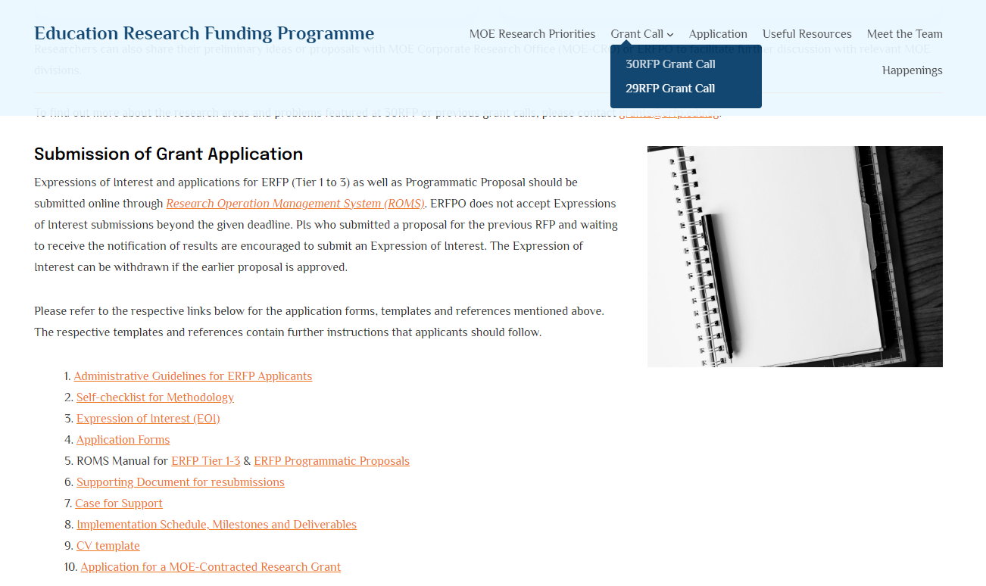
30RFP ERFP Website
The grant call information can be found on the ERFPO Website > 30RFP Grant Call
30RFP Grant Call Tab
Downloadable materials for use/reference

Slide 23
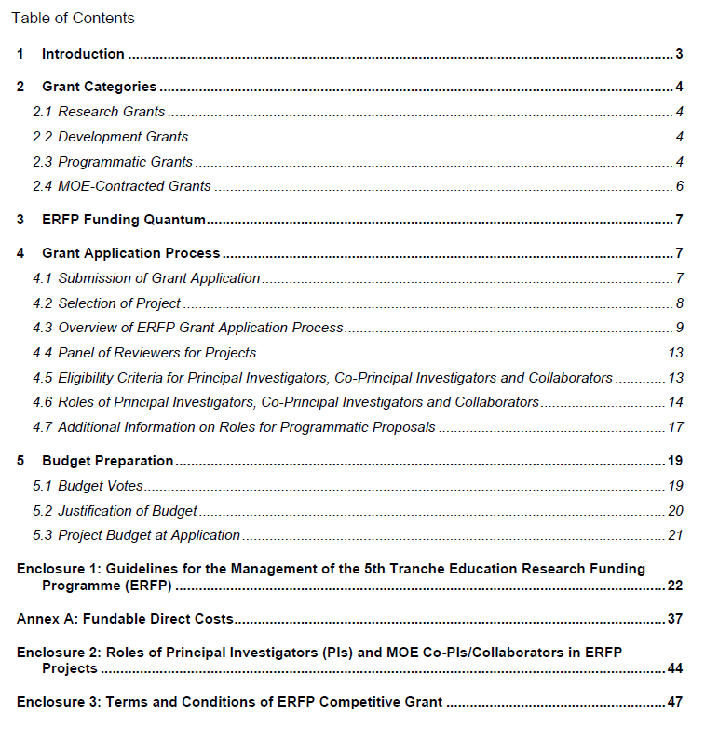
ERFP Administrative Guidelines​
Grant categories
Application
Budget

Slide 24
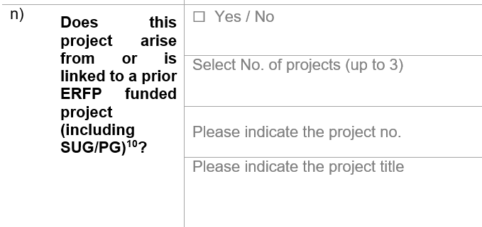
Proposal that arise from or linked to prior ERFP funded projects (including PG/SUG)
MOE is interested in knowing how current proposals are built on prior ERFP funded projects.
For proposals that arise from or are linked to prior ERFP funded projects (including PG /SUG), indicate "Yes" in the Application Form and list the Project Number and Project Title.
Although not specified in the application form, please include an Annex or incorporate information in the Case for Support to explain the link (e.g. theoretical foundation, methodology, findings). This helps to justify your study.

Slide 25
Case for Support - Recommendations and Contingencies
Your Case for Support should cover the following items:
Research Project | Development Project
Objectives of the Research Project Relevance to MOE and IHL Goals and Directions Literature Review Purpose of Proposed Study Competitive / Comparative Advantage Description of Principal Investigator’s and Team Members’ Effort Level in Project | Purpose Relevance to MOE and IHL Goals and Directions Review of Current Development Landscape Project Life Cycle Evaluation Phase of the Development Competitive / Comparative Advantage Description of Principal Investigator’s and Team Members’ Effort Level in Project

Slide 26
Case for Support - Development Projects
This should broadly cover the following items:

Slide 27
Case for Support - Tips​
Although not specified in the application form, please also include brief comments on ethical considerations and contingency plans (especially for larger projects).
If you have engaged Research Staff who are not part of the project team to assist in the drafting of this Case for Support, please do acknowledge their effort.
Responsibilities of all team members must be stated including Co-PIs, Collaborators and RAs.
Teams should consider if members who contribute a very small number of hours add sufficient value to the team.
For projects which are exploratory or where results are dependent on previous stages, the Case for Support should include comments on the budget for the respective stages and tasks.
Programmatic Proposals should include a description of how the sub-projects are linked or in what ways they work together for greater synergy.

Slide 28
Case for Support – General Comments​
A focused and succinct literature review allows PIs to elaborate and justify their methodology.
Elaborate on the methodology to show how the study will address research rigour and address the research questions.
See the 'self-checklist for methodology', included with the grant call documents on the website.
Relevance
From the administrative guidelines “The primary aim of ERFP is to improve classroom practice, enhance student outcomes, build organizational and teacher capacities in Singapore schools, and inform MOE policies. Thus, proposals for ERFP funding must demonstrate relevance to MOE mission and goals and potential benefits to Singapore’s educational institutions” (page 1).

Slide 29
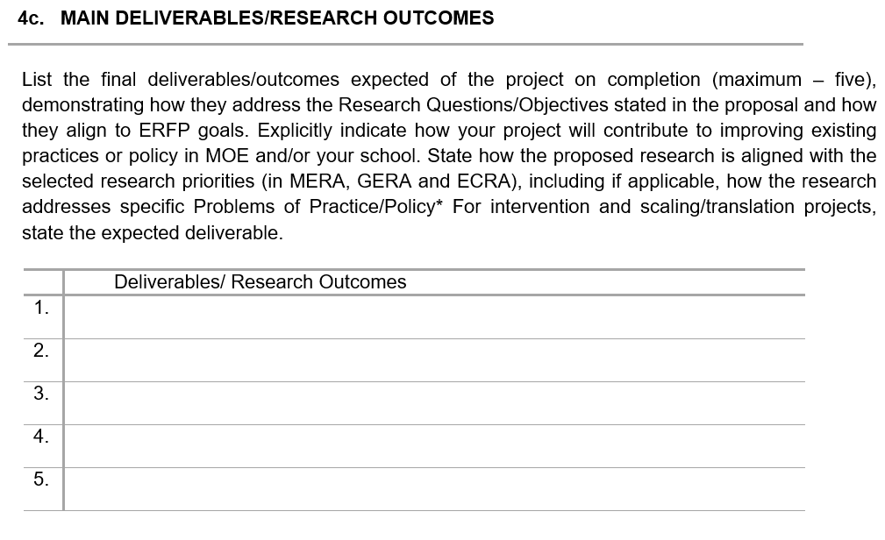
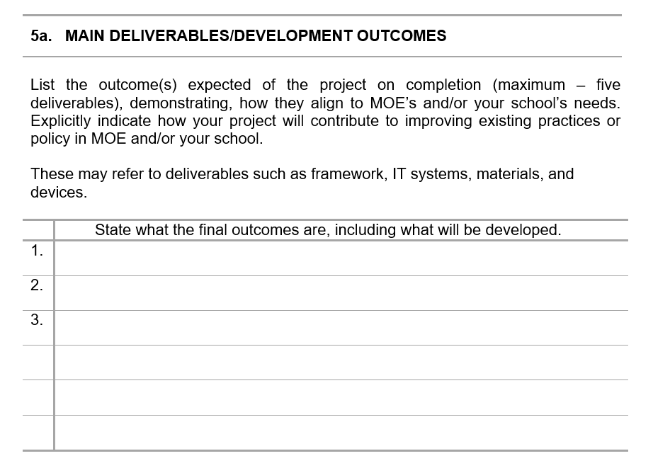
Research
Grant Application Form
Development

Slide 30
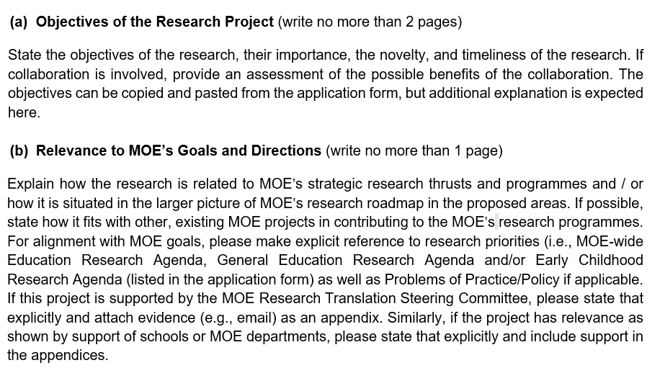
Case for Support
Show links to scope, to Research Programmes, to MOE Priority Areas, to prior ERFP-funded projects
To date, no projects have been ‘supported by the MOE/NIE Research Translation Steering Committee as this is a new process. Nevertheless, if your project is a translation/intervention based on a prior project, do explicitly state the link.

Slide 31
Case for Support - Page Allowance
Tier 1 and 2
No more than 20 pages
Maximum allowance of 4 pages for references, appendices and any tables or diagrams.
Tier 3
No more than 23 pages
Maximum allowance of 4 pages for references, appendices and any tables or diagrams.
Programmatic Research
No more than 25 pages
Information for each theme is to be included as Appendices (5 to 7 pages for each theme).

Slide 32
Gantt Chart​
The Research Implementation Schedule should include sufficient detail to show the progress of work in relation to the purpose, hiring, Research Associate/Assistant (RA) work, methodology and budget.
The Gantt Chart should be detailed and should align with justification of budget line items to show which work is undertaken when, how it relates to the budget, and especially to research teams (e.g. RA) costs.
Key tasks undertaken by Research Associates/Assistant/Research Fellows should be clearly indicated in the Gantt Chart to support the hiring period.
In particular, be sure to indicate RA work at each stage (e.g. instrument development, data archiving, final report preparation).
Some recommendations for PIs to consider:
Hiring period
Training period
Data collection, analysis and write up
Data management (e.g. institutional requirements for anonymizing, submission to data repositories, open access options)

Slide 33
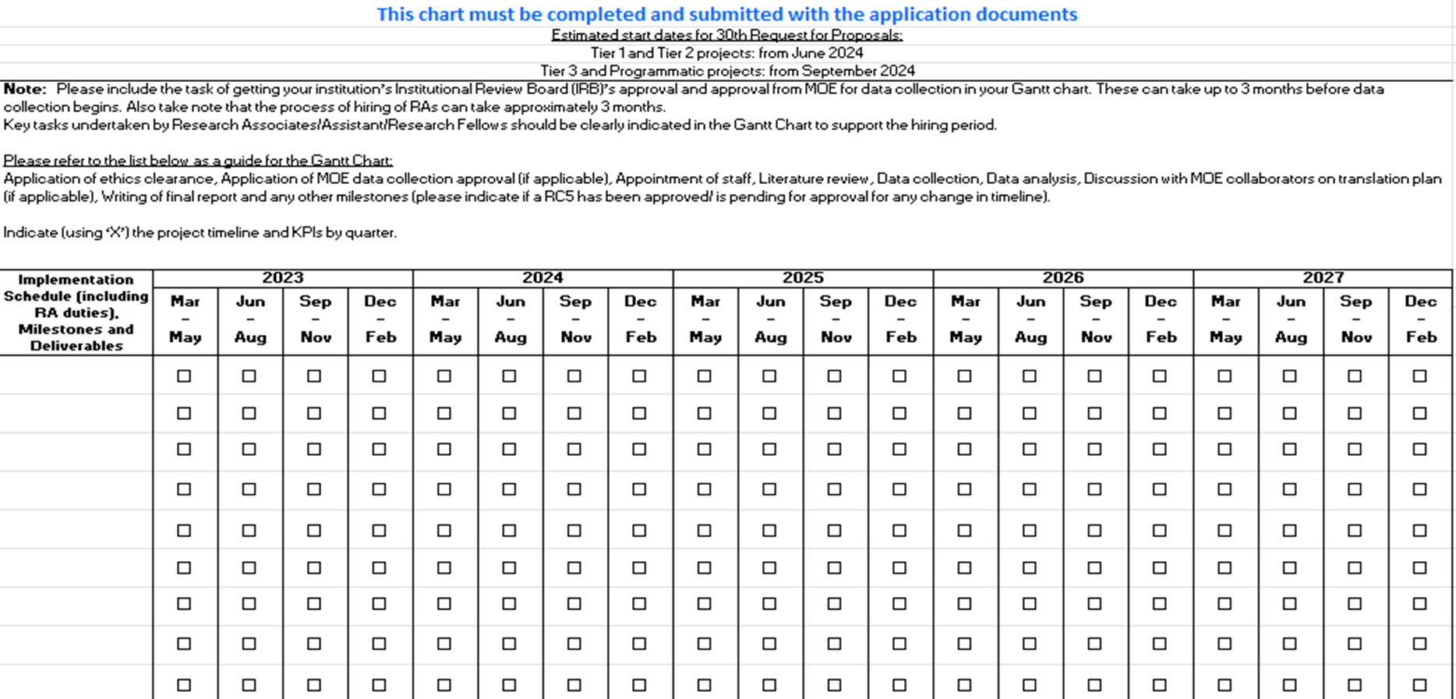
Gantt Chart​

Slide 34
Important Matters to Note
Project Duration:
Estimated Start date for Tier 1 and 2: June 2024
Estimated Start date for Tier 3 and Programmatic Proposal: September 2024
When planning project duration, factor in three additional months for ethics (IRB) approval and hiring of Research Staff.
Note that ethics approval will be done at each IHL based on their own standard procedures.
Co-PI:
The inclusion of a Co-PI from the same institution as the PI is mandatory for all proposals so as to ensure continuity of the project should the PI be unable to continue.

Slide 35
Finance Matters
Direct Cost
Human Resources Vote:
All related manpower costs for the duration of the hire (PB, AWS, medical benefits, insurance, hiring costs, etc.) must be included.
Equipment Vote:
Justifications and quotations must be provided for all equipment budgeted.
Note: Office equipment such as laptops, PCs, furniture and fittings, office software, photocopiers, scanners and office supplies are not allowed to be budgeted.
Only allowed if necessary for the Research or activity supported by the Funding and is not otherwise reasonably available and accessible; it the Expenses that are directly related to the project.
For high value equipment purchase ($20,000 and above), PIs are required to update the list of equipment acquired as part of the Half-Yearly Progress Report Submission.

Slide 36
Finance Matters
Other Costs Vote:
Clearly state the required software for the project together with justifications and quotations. Software purchase is allowed only if it is necessary to accomplish the project objectives. Software licenses period should not be longer than project duration.
Clearly state the required computer accessories and AV accessories together with justifications and quotations. Only allowed if items are directly related to the project.
Overseas travel/conference, including professional development for PI and Co-PI:
Capped at 5% of the total direct project cost, subject to a maximum budget of S$100,000 (for PP, cap is applied to the project as a whole).
Includes local conferences/workshops/seminars; local courses/online courses for PI and Co-PI as well as books, reference materials, lab manuals, specialized journals subscription.
Professional development (for full time Research Associate/Research Fellow):
Allowed for up to 2% of the original HR full-time budget, for local conferences/workshops/seminars; local courses/online courses.
Publication related cost:
Allowed up to $3,000 and includes publication charges in scientific publications, books, journals (including open access journals), articles, newsletters, brochures, posters, websites, conference materials, case studies and reports
Tokens of appreciation
Capped up to the equivalent of $10 per survey per person per project. Cash token is not allowed.
School personnel who are being approached to participate in the study on account of their official position or their official work and should not receive tokens of appreciation.

Slide 37
Finance Matters
Indirect Cost
Projects are provided with overheads (30% of direct costs) for 5th tranche
Management of Overheads should align with respective institute’s policies
Overheads are part of the tier quantum and should be included in project budget planning
Example:
VOTE | TOTAL COSTS ($)
Human Resource Costs | $80,000
Equipment Costs | $40,000
Consumable Costs | $40,000
Other Costs | $40,000
Total Direct Cost | $200,000
Institutional Indirect Research Costs (IIRC) (30% of Total Direct Cost) | $60,000
Grand Total | $260,000
Project Tier | 2

Slide 38
Finance Matters
Funding covers the 5th Tranche Education Research Funding Programme (FY2023-2027)
For detailed information on finance matters, PIs are to refer to the ERFP guidelines and T&C governing the ERFP grant
ERFP Guidelines and T&C will take precedence over respective institute’s guidelines and practices.
Payment of project-related claims/invoices to claimant/vendors will be made by IHLs based on respective institute’s guidelines and practices.
Project expenditure and overheads will be disbursed to IHLs on a quarterly basis by default¹.
All project activities and expenditure must be according to the approved budget line items and be incurred between the project start date and end date.
PIs should avoid purchasing certain items, such as equipment in the last three months of the project. (Refer to ERFP Guideline for details and other similar cases.)
PIs must ensure that there are sufficient funds in the four project votes before committing to any purchases or payments.
¹Separate arrangement may be made for selected IHLs

Slide 39
Finance Matters
Other matters
PIs are advised to be prudent, transparent and accountable for all project financial matters.
ERFPO aims to provide support to PIs and learn together to improve processes as we progress.

Slide 40
Additional Information
Contact Information
For general grants queries, please email ERFPO grants@erfp.edu.sg.
For technical assistance on ROMS, please email Research Operation Management System IT Support (NIE) servicedesk@nie.edu.sg.
For queries on Points of Contact (POCs) of the respective IHLs, please email ERFPO grants@erfp.edu.sg.

Slide 41
Q&A Session

Slide 42
Breakout Session
Room Number | Breakout Room Name | Facilitators
BR1 | Instructional Core | NIE: Dr Divya Bhardwaj
BR2 | Preparation of Programmatic Proposals | NIE: A/P Gregory Arief D Liem

Slide 43
Grant Submission Process For All Applicants

Slide 44
List of IHLs
Institute of Technical Education (ITE)
Nanyang Polytechnic (NYP)
Nanyang Technological University (NTU)
National Institute of Education (NIE)
National University of Singapore (NUS)
Ngee Ann Polytechnic (NP)
Republic Polytechnic (RP)
Singapore Institute of Technology (SIT)
Singapore Management University (SMU)
Singapore Polytechnic (SP)
Singapore University of Social Sciences (SUSS)
Singapore University of Technology and Design (SUTD)
Temasek Polytechnic (TP)

Slide 45
Grant Governance
All reviewers and panel members (e.g. Expert Panel, Recommending Panel) must declare any conflict of interest with any proposal.
The Approval Panels include representation from different levels to ensure there is separation of approving authority from grant applicant. The Tier 1 and Tier 2 Approval Panel is chaired by Dir/NIE, with representation from MOE (2 MOE Divisional Directors and will be selected by MOE).
The ERFP Recommending Panel is co-chaired by Dean OER/NIE and Director, Corporate Research Office/CRO and includes representation from MOE divisions.
Both the panels also include members from IHLs.

Slide 46
Grant Call Submission Details – ERFP Tier 1 - 3 & Programmatic Proposal Applications
Expressions of Interest (EOI) – 10 October 2023, 5pm
EOIs are required to be submitted for all Tier 1 to 3 and Programmatic Proposals to ERFPO via ROMS.
IHL POCs will be required to collate the names of researchers who would like to submit an EOI and send them to ERFPO Office via email at grants@erfp.edu.sg before 5pm, 5 September 2023.
ERFPO will liaise with POCs who have submitted the collated names of researchers about gaining access to the Research Operation Management System (ROMS) account. ROMS accounts will be provided for the respective applicants as well as the Director of Research (DoR) within your institution.

Slide 47
Full Proposal Submission Details – ERFP Tier 1 - 3 & Programmatic Proposal Applications
Full Proposal Submission: 25 October 2023, 5pm
All applications for ERFP (Tier 1 to 3) as well as Programmatic Proposals are submitted directly by applicants online via ROMS before 5pm, 25 October 2023. Only applicants who have submitted EOIs will be able to submit their full application via ROMS.
The submission deadline of all applications is by 5pm, 25 October 2023. ERFPO will not accept late or incomplete submissions after this deadline. Directors of Research (DoR) are required to endorse applications by 31 October 2023.

Slide 48
ROMS Manual for all applicants
Please refer to ERFPO’s website to download the manuals.

